Slide 1
Soap Web Services Introduction

Slide 2
Module Overview
In this Module, we will learn the following:
What is Web Services
Components of Web Service
Web Service Architecture
Web Service Jargon
Web Service Design

Slide 3
Introduction To Web Services
A webservice is software logic available across networks and platforms.
They are language independent like a .net webservice can be accessed by Java application.
They are best for building distributed applications.
Web services expose their resources adhering to recognized standards:
Uses HTTP protocol
A WSDL file describes all the functionality
Uses XML messages formatted with SOAP to communicate with other applications.

Slide 4
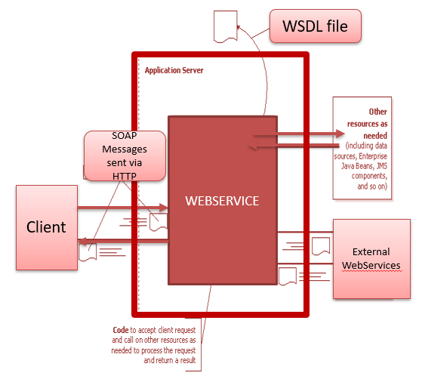
Web Service
We can see the interaction between the Webservice and the client.
The communication is done with the client using HTTP Protocol through XML Messages
The routing of incoming XML messages to the web service is done by the WebLogic Server

Slide 5
Web Service Jargon
Components of a Web Service
Web service helps to expose business logic through an API interface where different systems communicate over network. At higher level there are two parties involved, party providing the service is web service provider and the one utilizing it is web service consumer.
Application to application communication.
Interoperability between disparate systems.
Communication over network.
Exposed interface is platform independent and internal
implementation is abstracted.
Enables loosely coupled design.
Open protocol is used for establishing communication.
Web services are self contained.
STUB
INTERFACE
SKELETON
SERVICE LOGIC
TRANSPORT
Web Service Client
Web Service Provider

Slide 6
Web Service Jargon Cont..
Below are some of the important jargons associated with web service
Wsdl
Types
UDDI
Stub and Skeleton
Endpoint
Binding
Operation
SOAP
Message

Slide 7
Web Service Jargon Cont..
wsdl
It stands for Web Services Description Language (WSDL) and is a standard of W3C consortium used to describe a web service in an XML file.
It describes info like what is the message format, communication protocol, endpoint, security etc.
A published wsdl xml file is used by applications to use its services
Types
It is a vital part of WDSL used to describe the message attributes and types. XSD is the preferred format to describe the types. Type definition can be given in a separate XSD file & then imported in WSDL.
<definitions .... >
<types>
<xsd:schema .... />*
</types>
</definitions>

Slide 8
Web Service Jargon Cont..
UDDI
It stands for Universal Description, Discovery and Integration and is a directory service.
Web services can register with a UDDI and make themselves available through it for discovery.
It is like an Event broker : People ready to get registered for concerned event, they will describe themselves in a standard format (WSDL) and register with event directory. People seeking event organizer will approach this directory and discover based on the information provided and approach.
Stub and Skeleton
Stub and skeleton are counterparts in a web service setup.
Skeleton belongs to service provider side and stub belongs to receiver side.
At lower level stub and skeleton communicate with each other.
From client side the business objects communicates with stub objects and stub takes the responsibility form the message and invoke the web service.
Once the invoking is done, at service provider side, skeleton is the parallel object for stub and it receives the request message and understands it and passes on the information to service side business objects.

Slide 9
Web Service Jargon Cont..
Endpoint
An endpoint is a particular network location with associated protocol which includes message format mapping using which we can access that instance of web service.
This is described in WSDL file.
We can consider this as a handle using which we will access the web service.
Binding
Associating an interface with a protocol and message format is binding.
It is used in endpoint definition. Binding is described in WSDL.
Operation
A single logical grouping of a meaningful action which comprises a request and response is an operation.
Group of operations forms a web service.
SOAP
Simple Object Access Protocol is a XML based specification for web services message format and communication over network.
It helps to describe the transport method and message format in a web service.
Message
Data that is used to communicate to and fro with a web service is a message.
It is a standalone entity which comprises of complete information for a request or a response.

Slide 10
Web Service Design
Web Service Design
Web service has logic and an interface. Logic is the actual service provided and interface is used to communicate with the web service. Interface definition is given in WSDL. There are two approaches in implementing a web service and they are bottom-up and top-down.
Bottom Up Approach
Bottom up approach is where we first define the logic of a web service and then using that we will build the interface.
Service code is written first and then the WSDL is created using the service code.
There are tools available to generate the wsdl file automatically based on it.
Top Down Approach
Top down is the reverse of bottom up approach.
First the service definition is written up.
WSDL is created first.
The complete service definition, message format, transport protocol, security and everything is described in WSDL.
Then service is written after the WSDL.
Using that wsdl the skeleton code is generated automatically and after that the service code is filled up

Slide 11
Summary
In this Module, we have learnt the following:
What is Web Services
Components of Web Service
Web Service Architecture
Web Service Jargon
Web Service Design

Slide 12

Thank You

